Slide 1



RRN : 230282601091
NAME : H.NOORULLA
SUBJECT : WEB DEVELOPMENT
SUB CODE : CAE7128

Slide 2
BUILD
YOUR
OWN APP
by NOORULLA

Slide 3



Nannu
Creating an app involves several stages, from conceptualization to development, and eventually to deployment. Since the app's name is "Nannu," we can start by defining what the app will do. AND the APP is one of the primary purpose.

Slide 4

Vision
User-Centric Design:
Focus on creating an intuitive and engaging user experience.
Regularly gather and incorporate user feedback to improve the app.
Innovative Features:
Continuously innovate and add new features that enhance productivity and goal management.
Leverage technology like AI to provide personalized recommendations and insights.
Community and Support:
Build a community around the app where users can share tips and support each other.
Provide excellent customer support to help users maximize the app’s potential.
Continuous Improvement:
Regularly update the app to fix bugs, improve performance, and add new functionalities.
Stay ahead of trends in productivity and task management to keep the app relevant and useful.
Accessibility:
Ensure the app is accessible to a wide range of users, including those with disabilities.
Offer the app on multiple platforms (iOS, Android, Web) to reach a larger audience.
By adhering to this vision and continually striving to meet and exceed these objectives, "Nannu" can become a leading app in the productivity space, helping users across the globe achieve their highest potential.

Slide 5

Mission
"Our mission is to empower creators, professionals, and businesses by providing a versatile and user-friendly portfolio app that showcases their work, achievements, and skills. We aim to facilitate seamless presentation, promote personal branding, and connect users with opportunities through innovative features and an intuitive design."

Slide 6

NAVIGATION MENU
PORTFOLIO
HOME
CONTACT
ABOUT
SERVICES

Slide 7

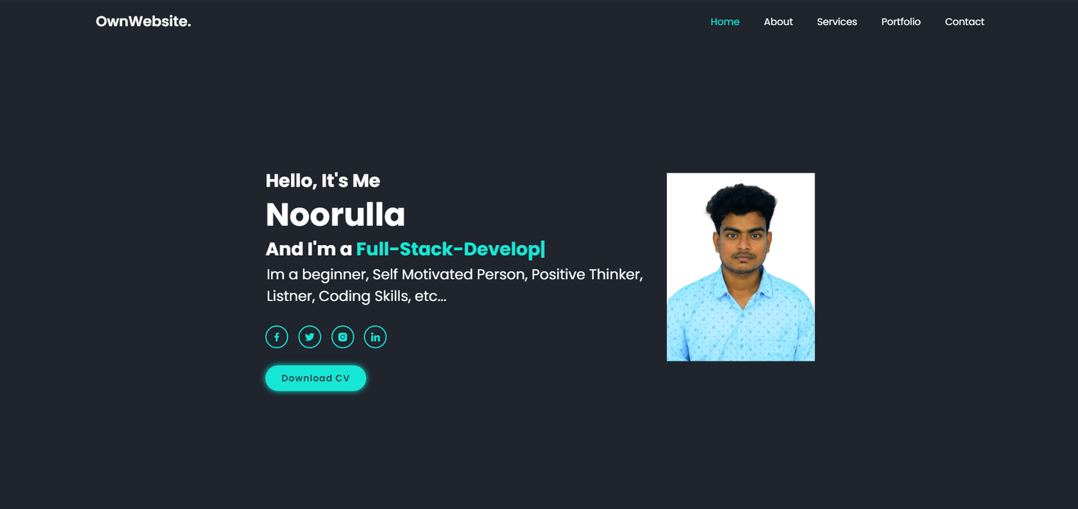
HOME

Slide 8
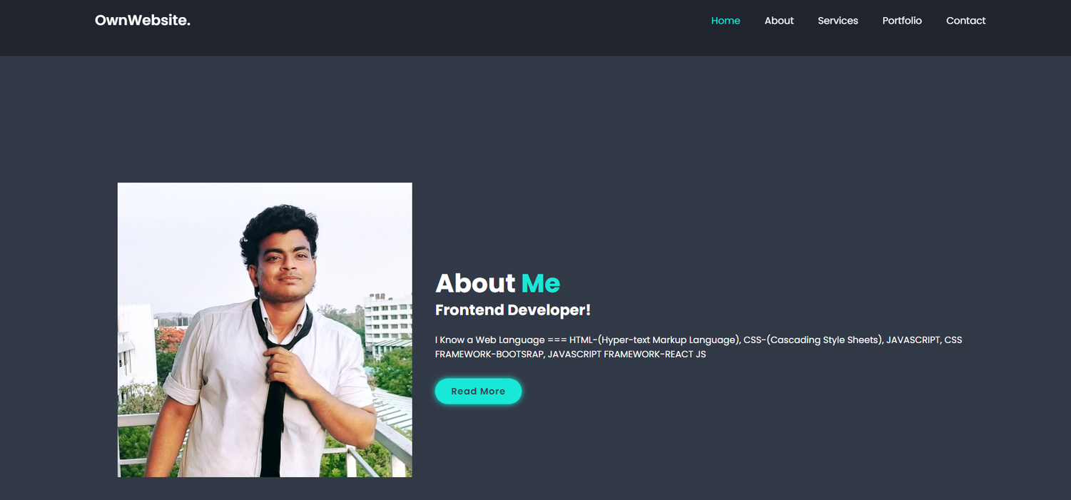
ABOUT

Slide 9
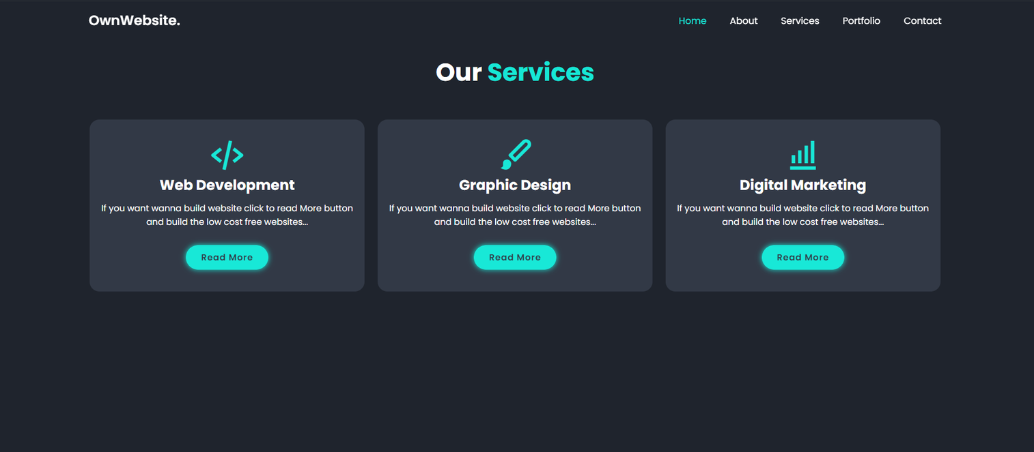
SERVICES

Slide 10
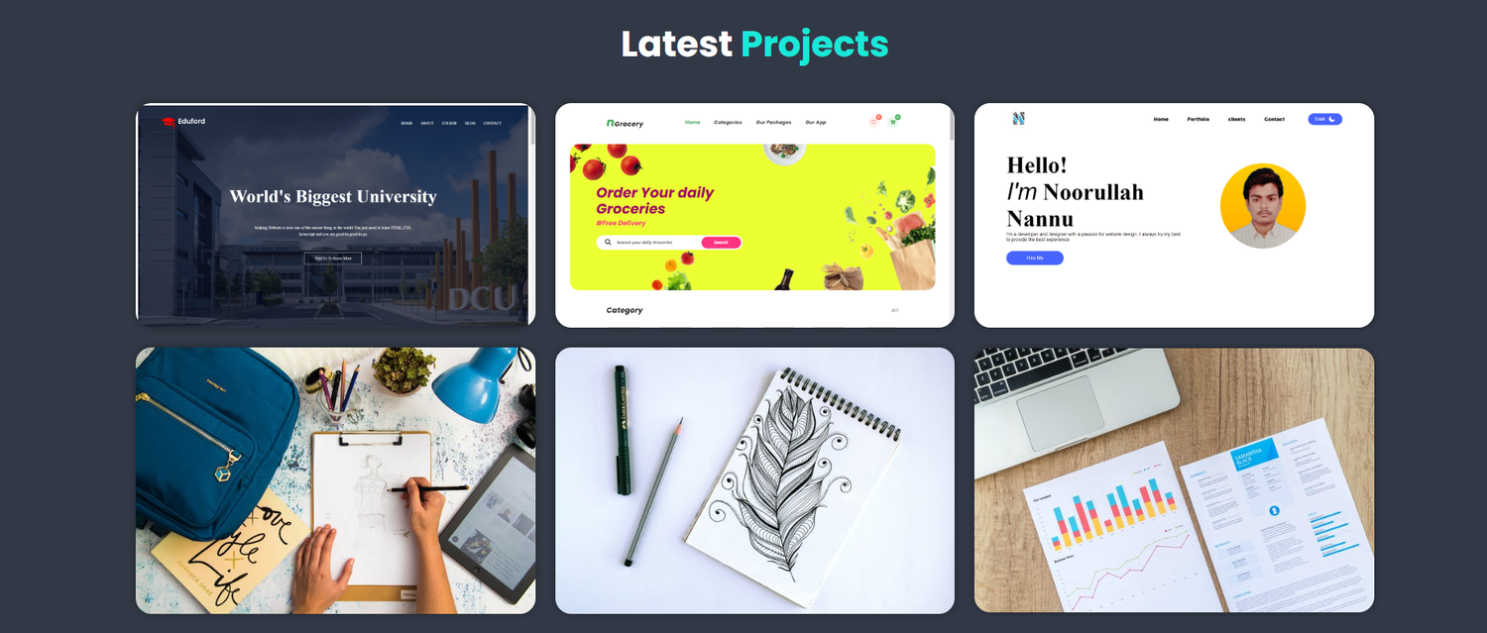
PORTFOLIO

Slide 11
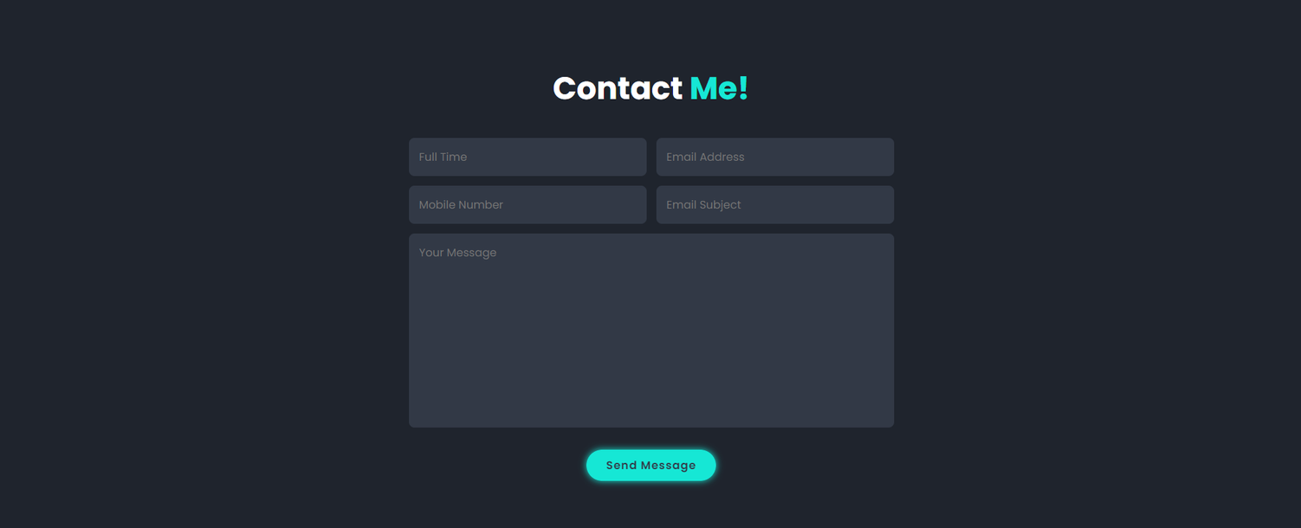
CONTACT

Slide 12
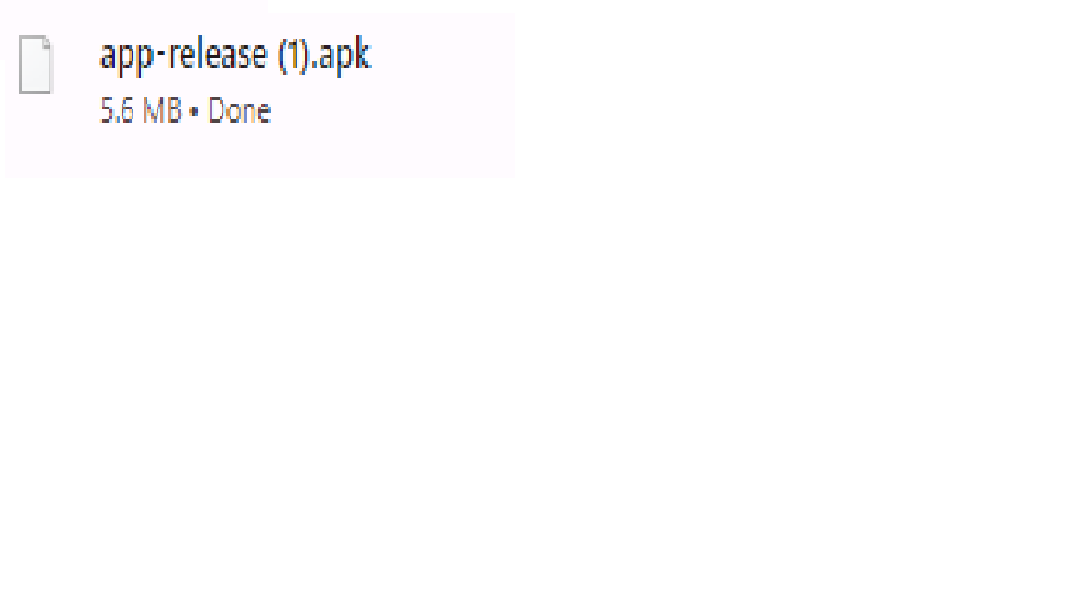
APK FILE

Slide 13
LINKS
LIVE DEMO - https://tech-noorulla-nannu.github.io/BuildOwnApp/

Slide 14


Thank You

